Slide 1
Digital Portfolio
STUDENT NAME: M.PRITHIMA SHRI
REGISTER NO AND NMID: 212401022and6F9CE5D034A10CAA2714B216EFB55CD8
DEPARTMENT: COMPUTER APPLICATIONS
COLLEGE: UNIVERSITY OF MADRAS

Slide 2
PROJECT TITLE
DIGITAL PORTFOLIO USING FRONT END WEB DEVELOPMENT

Slide 3


AGENDA
Problem Statement
Project Overview
End Users
Tools and Technologies
Portfolio design and Layout
Features and Functionality
Results and Screenshots
Conclusion
Github Link
3/21/2024 Annual Review

Slide 4

Problem statement
In today’s competitive world, a portfolio often carries more weight than a traditional resume. While a resume lists skills, experiences, and qualifications in plain text, a portfolio shows evidence of your abilities through real work samples, projects, and achievements.

Slide 5

Project overview Brief Summary: Created a personal portfolio website to showcase my skills, projects, and achievements.

Slide 6

WHO ARE THE END USERS? College students (both government and private institutions) School students (especially higher secondary students) Youth of Tamil Nadu who want to improve their employability skills, soft skills, and technical .

Slide 7

TOOLS AND TECHNIQUES HTML: ->Structure ->Heading ->Image ->Links GITHUB: Hosting PlatForm

Slide 8
POTFOLIO DESIGN AND LAYOUT
Portfolio Design Overall look and feel of the portfolio Use of headings, images, and text to represent information Should be simple, clear, and professional
Portfolio Layout Header – Name, title, navigation links About Section – Short introduction/profile Skills Section – List of technical and soft skills
8

Slide 9
FEATURES AND FUNCTIONALITY * Scrolling . * Showcase Image in project. * Interactive elements. * It showcase my details. * At last the portfolio can be viewed in github.

Slide 10
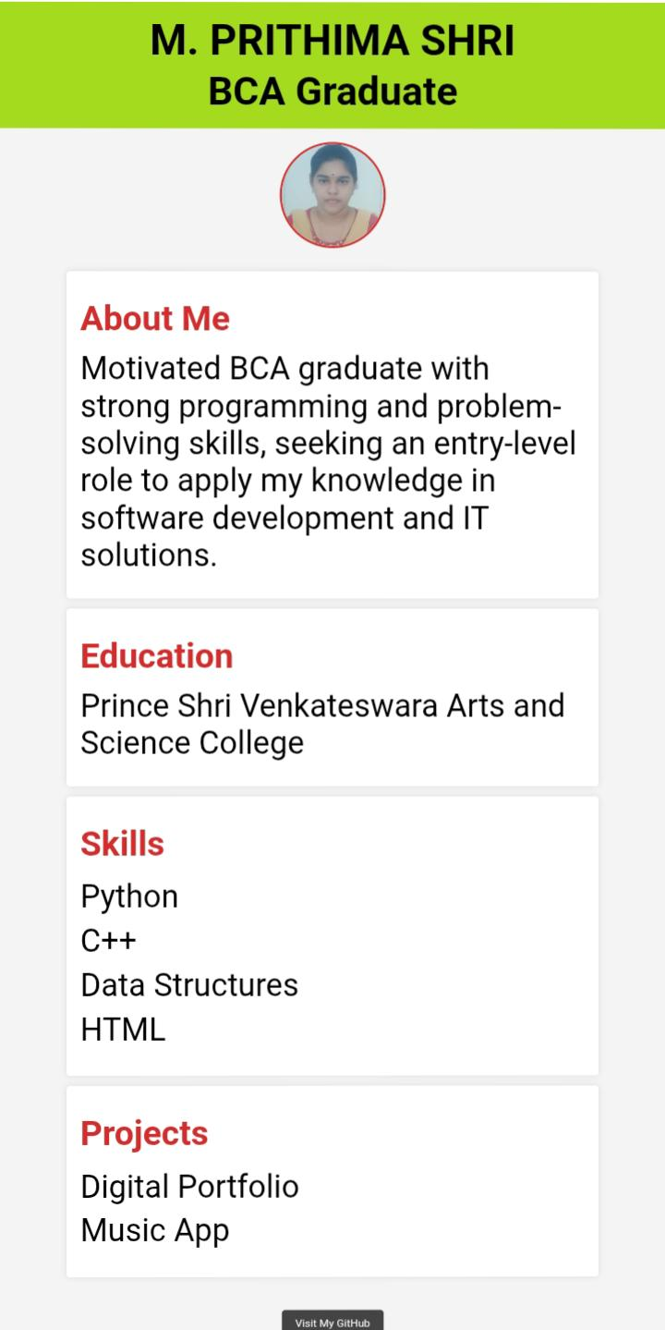

RESULTS AND SCREENSHOTS
3/21/2024 Annual Review
10

Slide 11
CONCLUSION My portfolio highlights my skills, projects, and learning journey, reflecting my dedication to growth and creativity. It serves as a showcase of my abilities and a step toward achieving my future goals.
11

Slide 12
Github Link https://13384bca2024-hub.github.io/digital-portfolio/

